Slide 1
Social Media
Akshaya Prasad
Chen Fang, Huang
Heng Yu, Tang

Slide 2
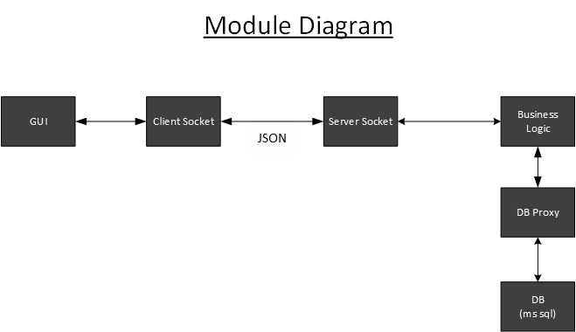
Module Diagram

Slide 3
Sequence Diagram

Slide 4
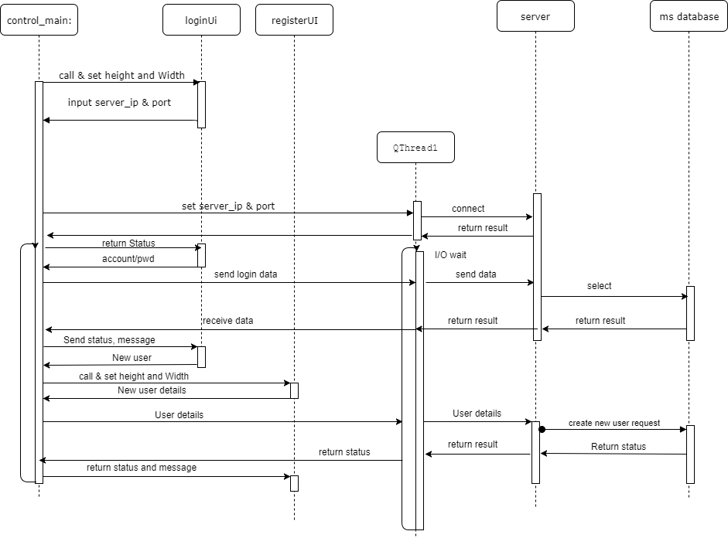

Slide 5
Class Diagram

Slide 6
